Slide 1
Microsoft® Office Excel 2010
Lesson 5 Viewing and Printing Workbooks
Courseware #: 3243

Slide 2
Lesson Objectives
create and arrange worksheet windows
split and freeze panes
zoom in and out of worksheets
print and preview worksheets
use different workbook views
add and preview page breaks
change margins, orientation, paper size and scale
print column and row titles or selected range of cells
add and modify headers and footers
change Excel options
Notes:
Pg 145
These are the objectives for this section. Go over these briefly so students know what to expect.
This section will focus on getting prepared to print and/or preview the report. When setting up the report for the worksheet, you may find that some students will need more explanations as to why you might want to set certain options such as headers/footers or titles.

Slide 3
Changing Worksheet Views
Monitors van be small – not enough space to display:
Large worksheet
More than one workbook at same time
Some computers still have small monitors , e.g. netbooks
View tab has many options to overcome limits of small monitors, and also useful for big monitors
Notes:
Pg 146
Objective 4.2
As per the book, computer monitors today are often very big – you can have two or more workbooks open at the same time and flip between them easily. If you have a small monitor (e.g. netbook), the View tab offers several options that are especially useful, such as freezing panes. Even if you have a big monitor, these features are useful when the worksheet is very big or when you need many workbooks open at the same time.

Slide 4
Creating and Arranging Worksheet Windows
Use New Window to open another view of active workbook
Then arrange windows to view different parts of workbook at same time
Use Arrange Windows to organize all open workbook views so all are viewable at same time
Usually used with different workbooks at the same time
No limit to number of views open
Size of monitor will limit number to use effectively at one time
Notes:
Pg 147-149
Objective 4.2
The exercise is a limited demonstration of the Arrange Windows capabilities. The book does show an example of each option. If time permits, have the students try each of the options.
It also demonstrates how to use the New Windows feature. Point out to students that this is an alternative to using the split panes feature (next topic).

Slide 5
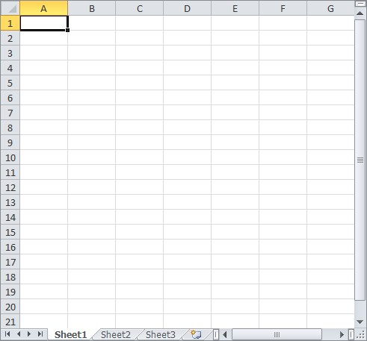
Splitting Panes
Horizontal Split Bar
Can split window into:
two panes, either horizontally or vertically
four panes with horizontal and vertical component
To split windows:
drag split bar to required location, or
On View tab, in Window group, click Split
Vertical Split Bar
Notes:
Pg 150-151
Objective 4.2
Provide examples of when or why you might want to split the active window into panes.
Have students try splitting the panes using the Window menu as well as the split bars. Also demonstrate how to reset the worksheet (removing the panes) by double-clicking on the split bars.

Slide 6
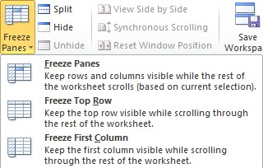
Freezing Panes
Feature that “locks” rows and columns on screen
Setting rows above and columns to left of active cell to freeze
Active cell used is important when this option activated
Freeze top row on screen
Freeze left-most column on screen
Cannot freeze and split panes at same time
Cannot freeze block of rows and columns in middle of worksheet
Notes:
Pg 152-153
Objective 4.2
Discuss when or why you might want to set Freeze panes and how to determine where you want to set the freeze, e.g., which cell to use, how much information on the left, etc.
Point out how you don’t need to set the cursor when you want to unfreeze the panes.

Slide 7
Changing the Zoom
Changes display magnification of worksheet on screen
Several preset magnification levels available:
On View tab, in Zoom group, click zoom option, or
On Status bar, click Zoom Out or Zoom In or drag Zoom marker
Select a magnification level:
On View tab, in Zoom group, click Zoom, or
On Status bar, click Zoom Level
Notes:
Pg 154
Objective 4.2
The Print Preview screen also has a zoom in and out capability, but with only two magnification level (none and zoom in).

Slide 8
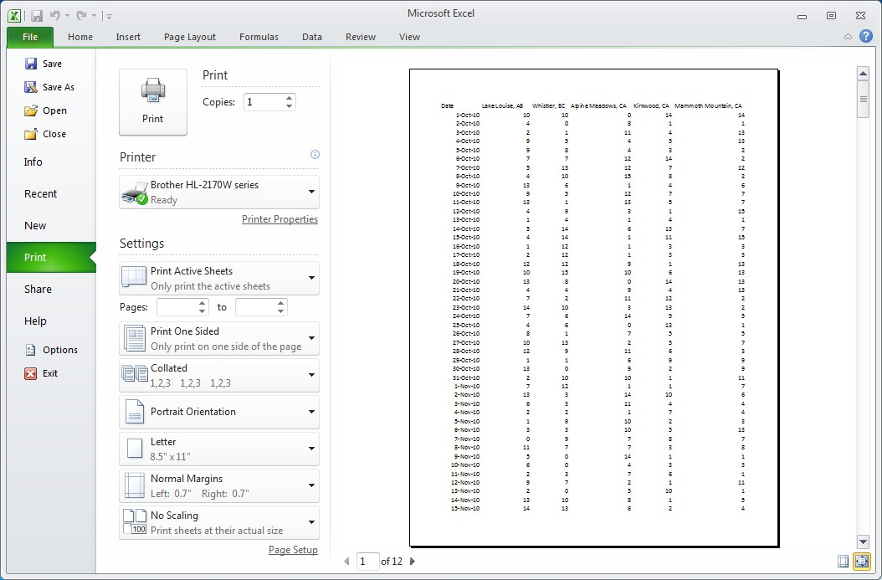
Printing and Previewing
Print also displays a print preview of workbook
Page setup settings
Magnifier
Margin markers
Notes:
Pg 155-156
Objective 1.2
One of the best things a user can do is to preview the worksheet prior to printing in order to prevent constantly printing the report over and over. Often items such as one or two columns being printed on a separate page can be prevented by previewing the worksheet and then changing the setup to make the report fit on a page.
Show students how to access the Print feature, then demonstrate how to scroll through the pages of a large worksheet and use the magnifier to zoom in and out of the report.

Slide 9
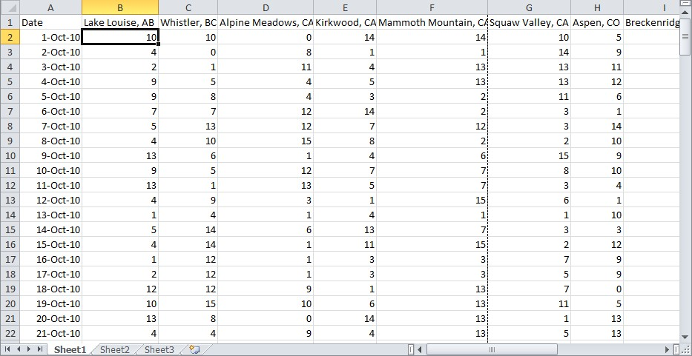
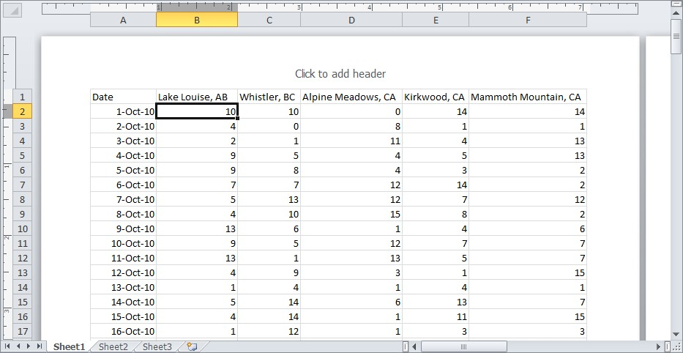
Workbook Views
Normal view (default)
Cell data only
Page Layout view
Cell data
Page headers and footers are displayed and can be changed
Ruler to show margins
Notes:
Pg 156-157
Objective 4.3
This topic is discussed at this point to give students an overview of the different kinds of workbook views available. The Page Layout and Page Break Preview views are discussed in more detail later in this book.

Slide 10
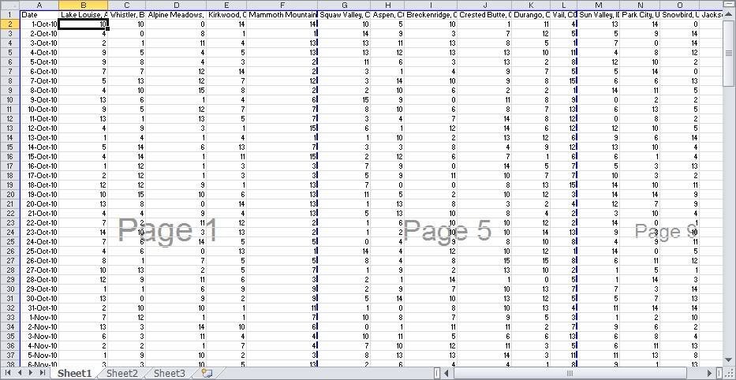
Workbook Views
Page Break Preview
Cell data
Clearly identifies what data printed on each page
Can insert or adjust page breaks
Custom
Current page layout settings saved, e.g. zoom level
Full Screen
No menu, Ribbon, or Status Bar
Notes:
Pg 158-159
Objective 4.3
Point out that the Custom and Full Screen views also exist, even though they are not discussed in any detail in this book.
Have an open discussion with students about the difference between Print Preview, Page Break Preview, and Page Layout view. How are they different and when would they use one over another?
Page Layout view – Used to view the contents of a page including the header and footer
Page Break Preview – Used to see which sections of a worksheet will be printed on which page
Print Preview – Use to view the entire page, but cannot make changes on this screen.

Slide 11
Customizing the Page Layout
Default page layout settings:
Margins: 0.75” top and bottom, 0.7 left and right
Portrait
Paper size: letter or A4
No scaling
No header or footer
No gridlines or row and column headings
Page order sequence is down, then over
Notes:
Pg 159
Objectives 1.2, 3.5
Have a quick discussion of each of the settings. They are covered in more detail later in the lesson.

Slide 12
Setting Page Breaks
When worksheet too large to fit on paper
Excel selects where page breaks will occur
Manually insert or remove page breaks at cursor location
Scale to Fit in Ribbon will override any manual page breaks
Notes:
Pg 160
Objectives 1.2, 3.5
Provide examples of why you want to put in page breaks and how these are different than just letting the report flow from the first row onwards.
Point out how page breaks are two-dimensional – the break appears above and to the left of the cell where the manual page break was inserted. Make sure they recognize this, especially when wanting to remove the page break. Draw their attention also to the visual clue for page break line types.

Slide 13
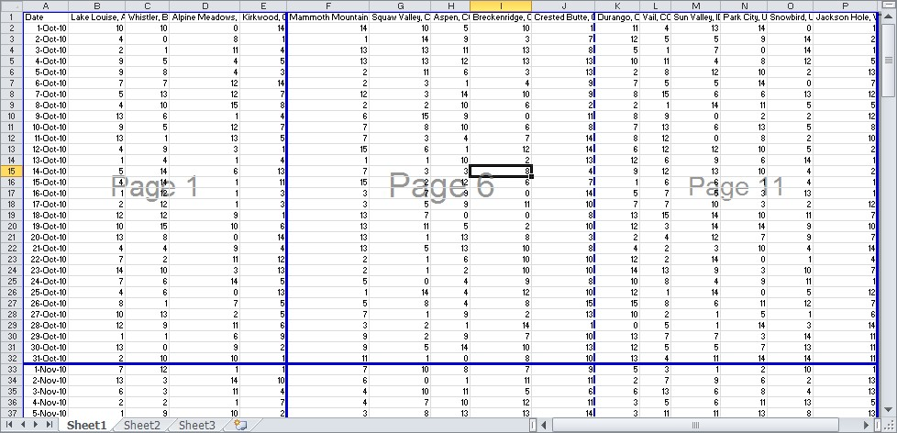
Setting Page Breaks
Page Break Preview
view of spreadsheet with page numbers as watermark
can drag page breaks to new position
Default page breaks appear as dotted lines
Manually inserted page breaks appear as solid lines
Notes:
Pg 160
Objectives 1.2, 3.5
Provide explanations as to why you might want to use the Page Break Preview mode for page breaks and then how to adjust the page breaks inserted.

Slide 14
Page Formatting
Page Layout tab changes how printed output will look
Commonly used settings:
Margins
Orientation: portrait versus landscape
Size of paper
Width, height, scale
Notes:
Pg 164
Objectives 1.2, 3.5
Discuss what the normal or default options are for printing worksheets and then take them into this tab so they can see what can be changed, as required. Have them use the Print Preview button from this screen to see instantly what changes have been made and how they affect the report. You can then also have them try playing with some of the other options in the Preview toolbar so they can see how some of these options can be adjusted from here, instead of the Page Setup dialog box.
A useful technique to teach is Scaling. Use the Fit to section to get Excel to calculate the % to scale down, then switch to Adjust to to manually set the desired scale. This technique works very well because worksheets often have unseen blank data in some cells, causing the scale to be incorrectly calculated.
NOTE: The Page Setup dialog box is no longer discussed in any detail in this book. In fact, this book avoids dialog boxes for most topics because the design of the Ribbon has changed how we use Excel and other Office products. The most commonly used features are now accessible from the Ribbon and many options are now only available on the Ribbon.

Slide 15
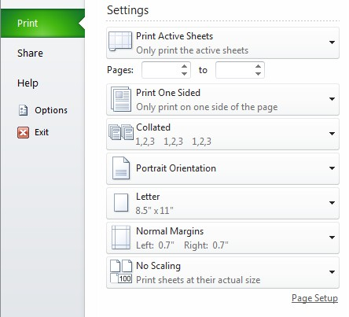
Page Formatting
Can also format from Print option under File (Backstage) tab
Notes:
Pg 166
Objectives 1.2, 3.5
Point out the formatting options here are the same as the common ones discussed in Page Layout tab.

Slide 16
Adding a Header or Footer
Text printed at top or bottom of every page for current worksheet
Most common headers or footers provided and can be customized
Notes:
Pg 168
Objectives 1.2, 3.5
Discuss how headers and footers can be used as well as things to watch for when entering these in, e.g., margins for header and top margin, size or length of text used in header/footer, etc.
The next two slide will describe the codes they can insert into headers/footers. Be prepared to provide examples of when or how you might use each.

Slide 17
Adding a Header or Footer
Boxes represent left, center and right areas
Auto-generated data can be inserted using Ribbon
Notes:
Pg 168-169
Objectives 1.2, 3.5
Make sure students understand that each option chosen displays a code to represent the data that will be inserted when the report is previewed or printed.
You may want to discuss how you don’t have to use these codes either, if they aren’t needed. However, there are some that are used frequently, especially when the report is time or date sensitive.

Slide 18
Printing Titles or Range of Cells
Print Titles repeats selected rows and/or columns at top of each page
Similar to Freeze Panes feature, but for printing
Print Area selects the cell range for printing
Remember to turn off after printing
Notes:
Pg 172
Objectives 1.2, 3.5
Discuss what some of these options are and when or why you might use them. For instance, in order to repeat the column rows for a large report, they will need to set the Print titles.
Make sure students recognize the difference between the Print area and the Print titles. Provide examples of when you might want to set a print area, e.g., print only the cash flow projects from the budget report instead of the entire budget.

Slide 19
Printing Selected Worksheets
Can select one of three options for printing:
print current active worksheet(s),
print entire workbook, or
print currently selected range of cells in current active worksheet.
To print more than one worksheet at same time, select all worksheets as group first
Use Ctrl to add worksheets to the group of active worksheets
Use Shift to select a range of worksheets as active group
Notes:
Pg 174
Objectives 1.2, 3.5
Discuss when you might want to print specific items in the workbook. Mention how Excel offers the same flexibility for printing items as the other Office programs, so if they are familiar with the ability to select only certain items in another program, reassure students they can do this also in Excel.

Slide 20
Changing Excel Default Settings
General tab
User Interface options
When creating new workbooks
Personalize your copy of Microsoft Office
Notes:
Pg 175-176
Objective 1.3
The exercise demonstrates some of the options that may be changed most frequently in the General tab:
Color scheme
Font size
Include this many sheets
User name

Slide 21
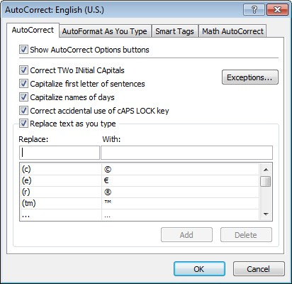
Changing Excel Options
Proofing tab
AutoCorrect options
When correcting spelling
Notes:
Pg 176
Objective 3.5
The exercise demonstrates how to change options in the Proofing tab, such as the AutoCorrect options.

Slide 22
Changing Excel Options
Save tab
Save workbooks
AutoRecover exceptions
Offline editing options for document management server files
Preserve visual appearance of the workbook
Notes:
Pg 176
Objective 3.5
Discuss with students some of the options in the Save tab:
Save files in this format
Save AutoRecover information every ….. Minutes
Default file location

Slide 23
Summary of Lesson 5
create and arrange worksheet windows
split and freeze panes
zoom in and out of worksheets
print and preview worksheets
use different workbook views
add and preview page breaks
change margins, orientation, paper size and scale
print column and row titles or selected range of cells
add and modify headers and footers
change Excel options
Notes:
Pg 179
Review the objectives as a quick summary so students recognize the skills they are starting to build.

Slide 24
Review Questions
1. Give examples of when it can be helpful to use the different types of worksheet window arrangement, e.g. tiled, horizontal, vertical or cascade.
2. Explain when you would split the panes of a worksheet instead of setting up a tiled arrangement of two or four windows.
3. Give examples of when you might freeze the panes.
4. Explain why you should preview a worksheet prior to printing.
5. Explain how the different worksheet views can help you with previewing or printing worksheets.
Notes:
Pg 179
No information has been provided in the slide for these topics for you to customize. Answers to the Review questions are found in the Appendix and can be used at the end or beginning of a class. Alternatively, you can also assign these for homework and then mark them at the beginning of the next class.

Slide 25
Review Questions
6. Give examples of when adding a header or footer can be helpful in the worksheet.
7. What is the difference between using the Scale and the Width and Height settings in the Ribbon?
8. Explain what are the similarities and differences between printing a header and printing titles for a worksheet.
9. Explain why you may want to access the Excel Options in the Backstage.
Notes:
Pg 179
No information has been provided in the slide for these topics for you to customize. Answers to the Review questions are found in the Appendix and can be used at the end or beginning of a class. Alternatively, you can also assign these for homework and then mark them at the beginning of the next class.

